Slide 1
Applicant Briefing
Public Assistance (PA) Program
FEMA-DR-4644-VA
“Severe Winter Storms, and Snowstorm”
Presented by the
Recovery Section of the
Virginia Emergency Support Team (VEST)

Slide 2
Agenda
General Public Assistance Overview
Roles and Responsibilities
Public Assistance Eligibility
Public Assistance Delivery Model
FEMA’s Streamlined Application Process Grants Portal Walk-through https://grantee.fema.gov
Submit Requests for Public Assistance (RPAs)
Adjourn

Slide 3
Goals
Important Dates & Deadlines
Become Familiar with FEMA’s Streamlined Application Process
Log into Grants Portal
Submit Request for Public Assistance (RPA)
Questions/Answers

Slide 4
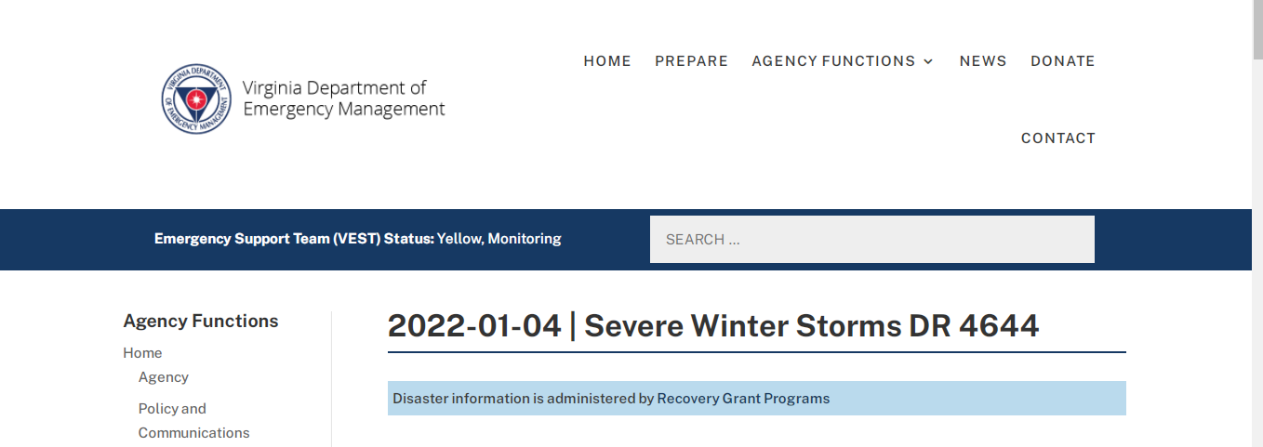
Resources
https://www.vaemergency.gov/disasters/2022-01-04-severe-winter-storms/

Slide 5
Public Assistance (PA)
Assistance to state and local governments, and certain private non-profit organizations, for use in the response and recovery phases following a Presidential disaster declaration.
PA is a reimbursement program based on eligible costs incurred.

Slide 6
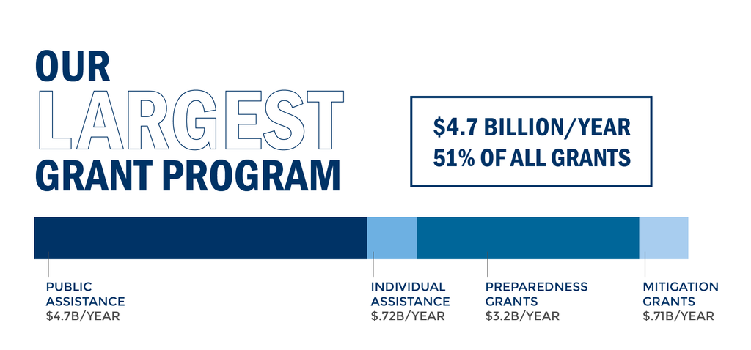
FEMA Grant Programs Snapshot

Slide 7
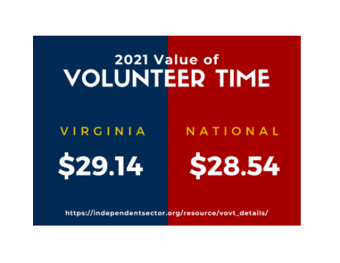
Public Assistance Cost Share
FEMA will reimburse no less than 75% of eligible costs for projects.
The non-federal share, remaining 25%
  State agency share – 0%
  Local government share – based on Local Council of Governments Fiscal Stress Index
  Tribal government share – 25%
  Private non-profits share – 25%
Thirds party donations for eligible work performed, if documented, may off-set the 25% non-federal share. The volunteer rate is $29.14 per hour.*
  *Virginia is currently seeking official approval for the volunteer rate if there are any donated resource projects for Category B

Slide 8




A Tale of Two Portals

Slide 9
Vdem.emgrants.com
A web-based portal which manages the Public Assistance (PA) Program
Was utilized for damage assessment process
Automatic feed from FEMA’s systems, so when funds are obligated you will see them in vdem.emgrants.com
Vdem.emgrants.com will be utilized from federal obligation through closeout.

Slide 10
Vdem.emgrants.com
Allows you to:
  Access project information
  Submit requests for reimbursement
  Monitor the status of payments
  Submit Quarterly Reports
  Request extensions and scope of work
  changes
  Generate financial reports
  Request for closeout of project

Slide 11
FEMA Grants Portal
      Submission of RPA
      Submission of documentation
      Projects are written and signed
      All reviews and approvals take place
      Monitor & Manage projects
      Creates Transparency across all levels of government
      Must use Microsoft Edge or Mozilla Firefox for full functionality

Slide 12
Roles and Responsibilities
Applicant | Recipient (VDEM) | FEMA
Creates/Maintains Organization Profile in Grants Portal (GP) Attends Applicant Briefing Submits Request for Public Assistance (RPA) in GP Completes Streamlined Project Application and Uploads in GP Provides supporting documentation | Activates Organization Profiles in GP Conducts Applicant Briefing(s) Reviews RPA and makes recommendation Administers Grant Awards Grant management including reimbursement requests, scope of work changes, time extensions, and closeout | Approve RPAs Determine Eligibility Issue Determination Memos

Slide 13
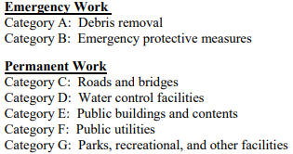
Declaration Summary
President approved Major Disaster Declaration on March 11, 2022.
Statewide Public Assistance
  All categories of work: A-G
Hazard Mitigation Grant Program (HMGP)
  All areas in the Commonwealth of Virginia are eligible
Cost Share: 75% federal, 25% non-federal

Slide 14
Incident Period
Eligible damages must have occurred between January 2-3, 2022 and be directly related to the disaster.

Slide 15
Potential Applicants
Potential Applicants for the PA grant program include localities, tribal government, state agencies and certain private non-profits in the following designated jurisdictions:
  Albemarle, Amelia, Appomattox, Bedford, Buckingham, Caroline, Charlotte, Culpeper, Cumberland, Essex, Fauquier, Fluvanna, Goochland, Greene, Hanover, King George, King William, Louisa, Madison, Nelson, Orange, Powhatan, Prince Edward, Rappahannock, Spotsylvania, Stafford and Westmoreland Counties and the independent city of Fredericksburg.

Slide 16
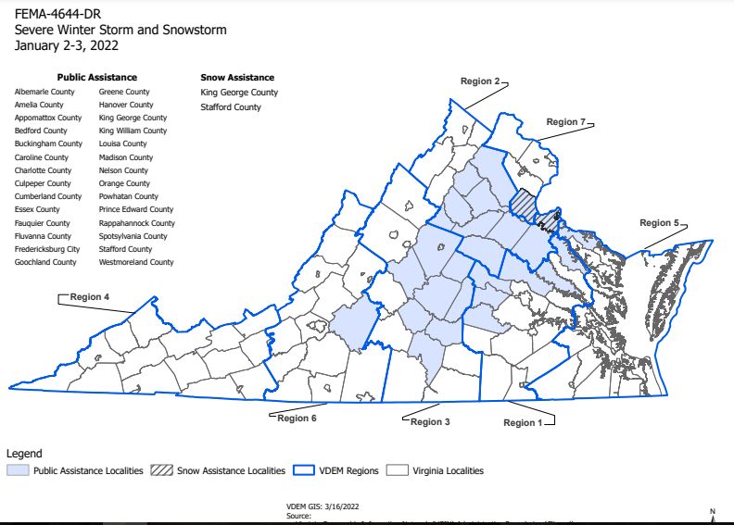

Slide 17
Snow Assistance
Is limited to eligible applicants in King George and Stafford County
Each eligible applicant will be able to select a 48 hour period in which they had their peak cost for snow removal costs.

Slide 18
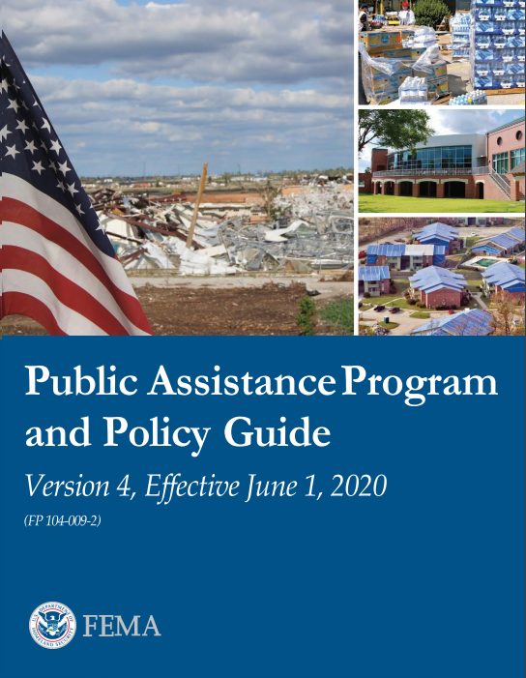
PA Program and Policy Guidance
Establishes guidance and eligibility criteria for the Public Assistance Program
https://www.fema.gov/sites/default/files/documents/fema_pappg-v4-updated-links_policy_6-1-2020.pdf

Slide 19
Eligibility Pyramid
COST
WORK
FACILITY
APPLICANT

Slide 20
Applicants
Only eligible applicants can apply directly to FEMA for reimbursement of eligible costs (Categories A-G).
Organizations that do not meet the definition of an eligible applicant, but are performing eligible work on behalf of an eligible applicant may seek reimbursement of costs through an MOU with the applicant

Slide 21
Eligible Applicants
  State agencies, colleges and universities, and community colleges
  Counties, cities, and incorporated towns
  Federally recognized tribal governments
  Special governmental districts, authorities, or boards
  Certain private non-profit (PNP) organizations

Slide 22
Private Non-Profit
Organizations
  Private Non-Profit organizations must have a ruling letter from the Internal Revenue Service (IRS) granting a tax exemption under Section 501(c), (d), or (e) of the IRS Code of 1954; or
  They must have documentation from the State substantiating that the non-revenue producing organization or entity is a non-profit entity organized or doing business under state law.

Slide 23
Eligibility
COST
WORK
FACILITY
APPLICANT

Slide 24
Eligible Facility
Located in disaster area
Not under the specific authority of another Federal Agency
Be in “active use”
Must be owned or operated by the applicant

Slide 25
PNP Facility Eligibility
For PNPs, an eligible facility is one that provides an eligible service, which includes education, utilities, emergency, medical, custodial care, and other essential social services.

Slide 26
PNP Facility
Required Documentation
If the Applicant owns the facility, proof of ownership
If the Applicant leases the facility, proof of legal responsibility to perform eligible work
List of services provided in the facility and when and to whom
Who is allowed membership
What fees are charged
Policy regarding waiving memberships

Slide 27
Critical PNP Facilities
Fire and emergency services
Electric power
Water supply & some irrigation
Telephone communications
Sewer & wastewater treatment
Direct medical care

Slide 28
Non-Critical PNP Facilities
Museums
Educational facilities
Zoos
Custodial care facilities
Libraries
Alcohol & Drug rehabilitation
Community centers
Battered Spouse Programs
Homeless shelters
Low-income housing
Shelter workshops Food programs for the needy
Senior Citizen Centers Daycare centers for special needs

Slide 29
Non-Critical PNPs
Must first apply for disaster assistance from SBA, and exhaust SBA loan assistance, or be declined by SBA before it can seek grant assistance for permanent repairs and/or replacements from the FEMA.

Slide 30
SBA Application Deadline
Applicants may apply online using the Electronic Loan Application (ELA) via SBA’s secure website at DisasterLoan.sba.gov/ela/s/ and should apply under SBA declaration # 17368.
Application deadline is May 10, 2022

Slide 31
Eligibility
4 Components
COST
WORK
FACILITY
APPLICANT

Slide 32
Eligible Work
Must be Direct Result of Disaster
Must be located within Designated Disaster Area
Must be Legally Responsible
Must be done to:
    Save lives
    Protect Public Health and Safety
    Eliminate or lessen the immediate threat

Slide 33

Categories of Work
Emergency Work – must be completed within 6 months (September 11, 2022)
  Category A – Debris Removal
  Category B – Emergency Protective Measures
Permanent Work – must be completed within 18 months (September 11, 2023)
  Category C – Roads and Bridges
  Category D – Water Control Facilities
  Category E – Public Buildings and Contents
  Category F – Public Utilities
  Category G – Parks, Recreational, and Other Facilities
Administrative Costs
  Category Z – Management Costs

Slide 34
Eligibility
4 Components
COST
WORK
FACILITY
APPLICANT

Slide 35
Eligible Costs
Incurred by an Eligible Applicant
Directly tied to the performance of Eligible Work
Necessary and reasonable to accomplish the Eligible Work
Properly documented
  Consistent with Applicant’s established policies (Insurance, personnel, etc.)
  As detailed in a Mutual Aid Agreement or Memorandum of Understanding (MOU)

Slide 36
Eligible Costs
Compliant with all Federal, State, Local Regulations
  Procurement
  Environmental & Historic Preservation
  Permitting
Reduced by all applicable credits (Insurance, Fair Market Value, etc.)
  Cannot be duplicated by multiple funding sources

Slide 37
Cost Categories
Direct Costs:
  Force Account (Inside Sources):
    Labor
    Equipment (FEMA rates apply)
    Materials
  Contract Costs – (Outside Sources)

Slide 38
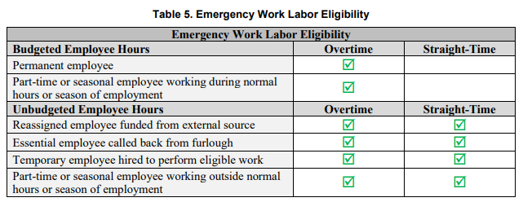
Cost - Labor
Labor rates must be based on the applicant’s pre-disaster labor policy, that is uniformly applied.
  Reference PAPPG V4 for information on force account labor, pages 68-71.

Slide 39
Cost - Equipment
Force Account Equipment
State, Local, or FEMA 2021 Equipment Rates https://www.fema.gov/schedule-equipment-rates
Other Leased/Rental Equipment

Slide 40
Cost - Supplies & Materials
Used for Eligible Work
Reasonable and Necessary

Slide 41
Cost - Contracts
Eligible if:
  Comply w/Federal, State, and Local procurement procedures 2 CFR 200.317-326
  Procurement Disaster Assistance Team
  https://www.fema.gov/procurement-disaster-assistance-team

Slide 42
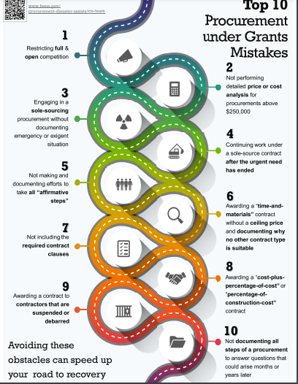
Challenge of Procurement Compliance
The reimbursement will eventually be a federal grant, so federal procurement requirements apply
Strongly recommend that applicant legal counsel is sought for procurement compliance.

Slide 43
Duplication of Benefits
FEMA PA Program cannot duplicate funding assistance received for the same purpose under other federal programs OR through insurance proceeds (i.e., FEMA PA is the last program for federal assistance)
FEMA may cover eligible costs not covered by other funding sources

Slide 44
Duplication of Benefits
While some activities may be listed as eligible for funding through multiple programs
  Final reimbursement determinations will be made by FEMA

Slide 45
Category Z- Management Costs
  FEMA provides contributions for managements costs based on actual costs incurred up to:
      5 percent of the total award amount for each Subrecipient.
  The total award amount, for the purposes of calculating cost contribution, is the actual eligible PA project cost (Federal and non-Federal Share) after insurance and any other reductions.
  In other words, you don't have to do this alone

Slide 46
Requirement for Reimbursement
DOCUMENTATION !
        DOCUMENTATION !
        DOCUMENTATION !

Slide 47
Documentation
Applicants are responsible for detailing their activities and providing supporting documentation, to include:
  Established policies: Insurance, personnel, procurement
  Insurance Statement of Loss or received reimbursement (if applicable)
  Invoices, estimates, or bids

Slide 48
Documentation
  Applicants have 60 days to report all damages from the Recovery Scoping meeting date.
  Force Account labor, equipment, and material quantities and rates/costs.
  2021 FEMA equipment rates: https://www.fema.gov/media-library/assets/documents/136901

Slide 49



Project Application
Declaration
RPA and Customer Service Reviews
Applicant Briefing (Virtual)
Grants Portal Account Creation and RPA
Applicant Review and Signature
Recipient Review
Streamlined Project Application
Customer Service Staff Assigned
FEMA Review
Obligation
Post Award Activities

Slide 50

Current Process
DISASTER
Initial Damage Assessment
Preliminary Damage Assessment
Joint Preliminary Damage Assessment
Project Formulation
  Exploratory Call
  Damage Inventory
  Scope Cost
  EHP
Recipient
Review
VDEM
VDEM
VDEM + FEMA
VDEM
VDEM + FEMA
Obligation
Post-Award
  Implementation
  Quarterly Reports
  Reimbursement Requests
  Scope Changes
  Extensions
  Cost Overruns
Closeout
  Final Inspection
FEMA
VDEM
VDEM + FEMA
=
Applicant Main Point of Contact

Slide 51
TYPES OF PROJECTS
TWO TYPES
  Small
  Large
  Determined by $ amount tied to
  completion of “Scope of Work”

Slide 52
Small Project Thresholds
$3,500 Minimum amount of eligible costs required to meet the threshold for Small Project Grants
Small projects costs is less than $139,800.
  Small project funding is based on estimated costs, if actual costs are not yet available.

Slide 53
Large Project Thresholds
Large project threshold amount:
  $139,800 or more based on documented actual costs.

Slide 54
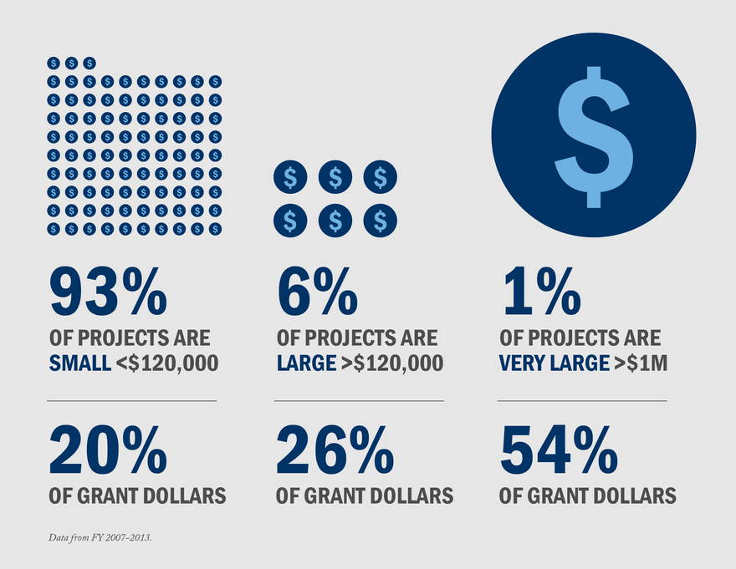
Historical Trends

Slide 55
RPA Submission
RPAs must be submitted in the FEMA Grants Portal – https://grantee.fema.gov
The RPA deadline is April 10, 2022.

Slide 56
Methods for Account Setup and RPA Submission
For an Applicant without a Grants Portal Account
For an Applicant with existing Grants Portal Accounts
An Applicant can create an account and submit an RPA directly through Grants Portal (DR-4602-VA Severe Winter Storms)
An Applicant can request an account from the Recipient
An Applicant can request an invitation from the Recipient to create an account
An Applicant can submit an RPA directly through Grants Portal
An Applicant can request an RPA is submitted by the Recipient on their behalf

Slide 57
Submitting your RPA in the FEMA Grants Portal:
Actions for an Applicants with existing Grants Portal Accounts

Slide 58
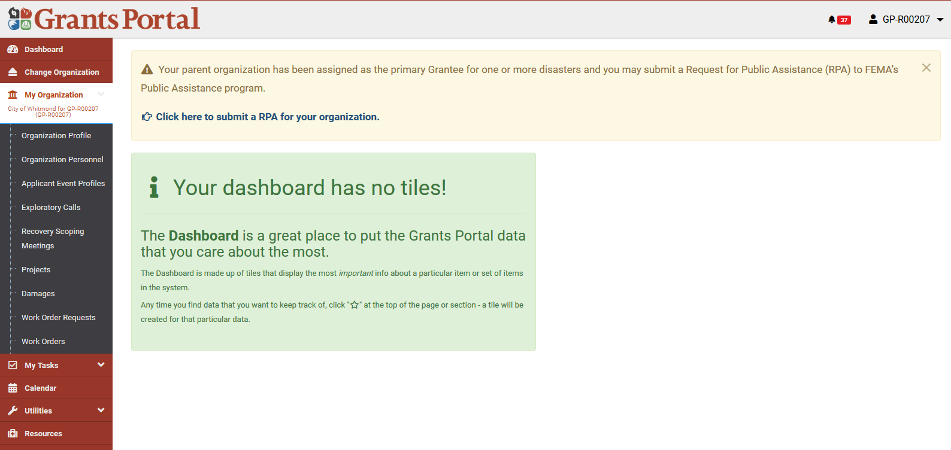

Slide 59
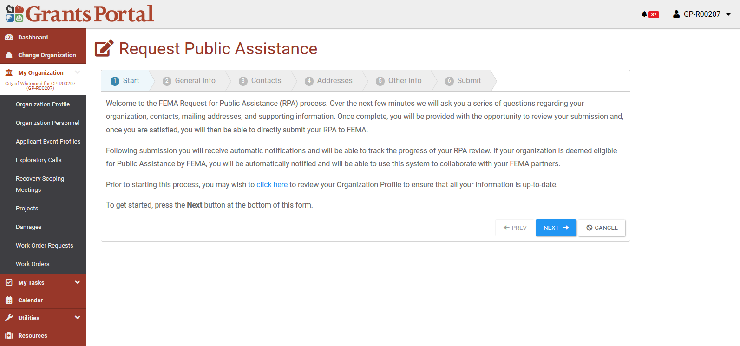

Slide 60
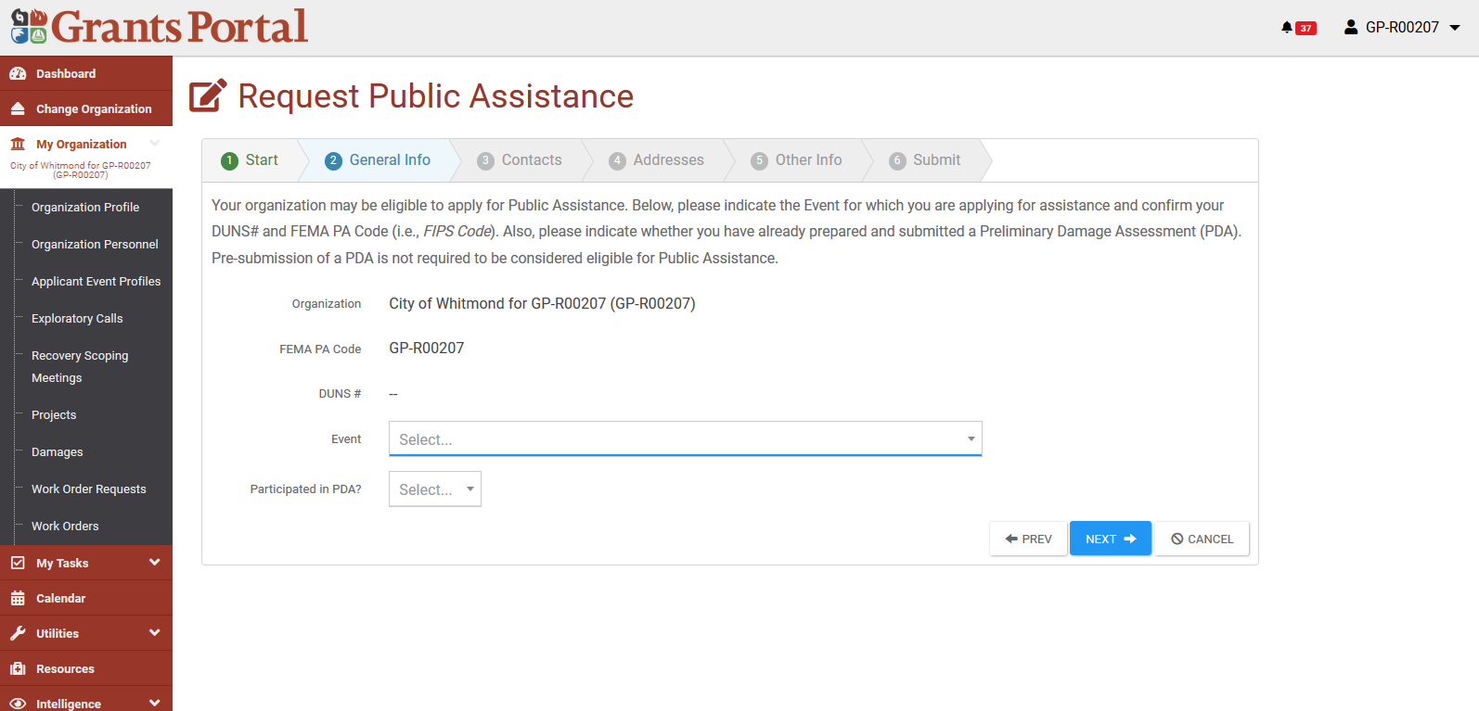
Step 1
Step 2

Slide 61
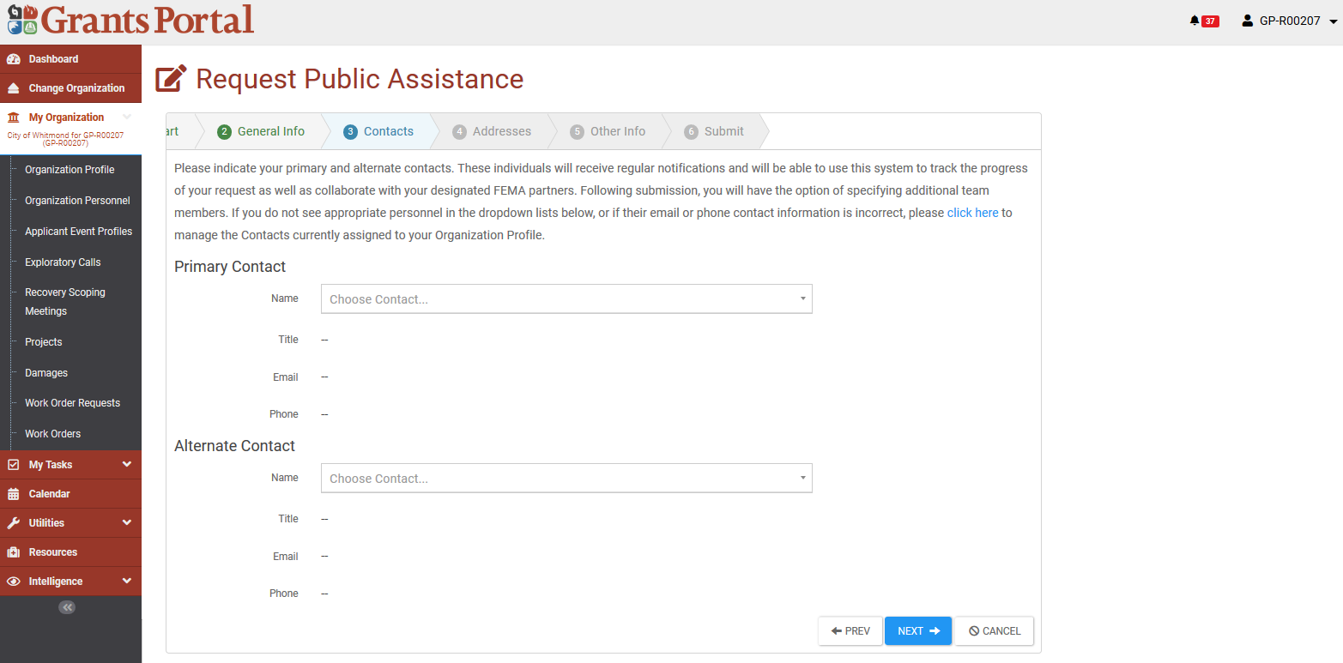
Step 1
Step 2
Step 3

Slide 62
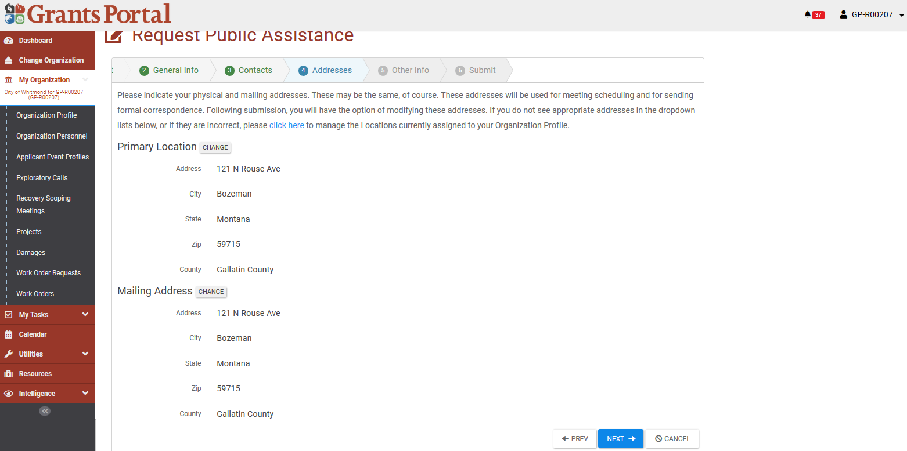
Review information then click Next

Slide 63
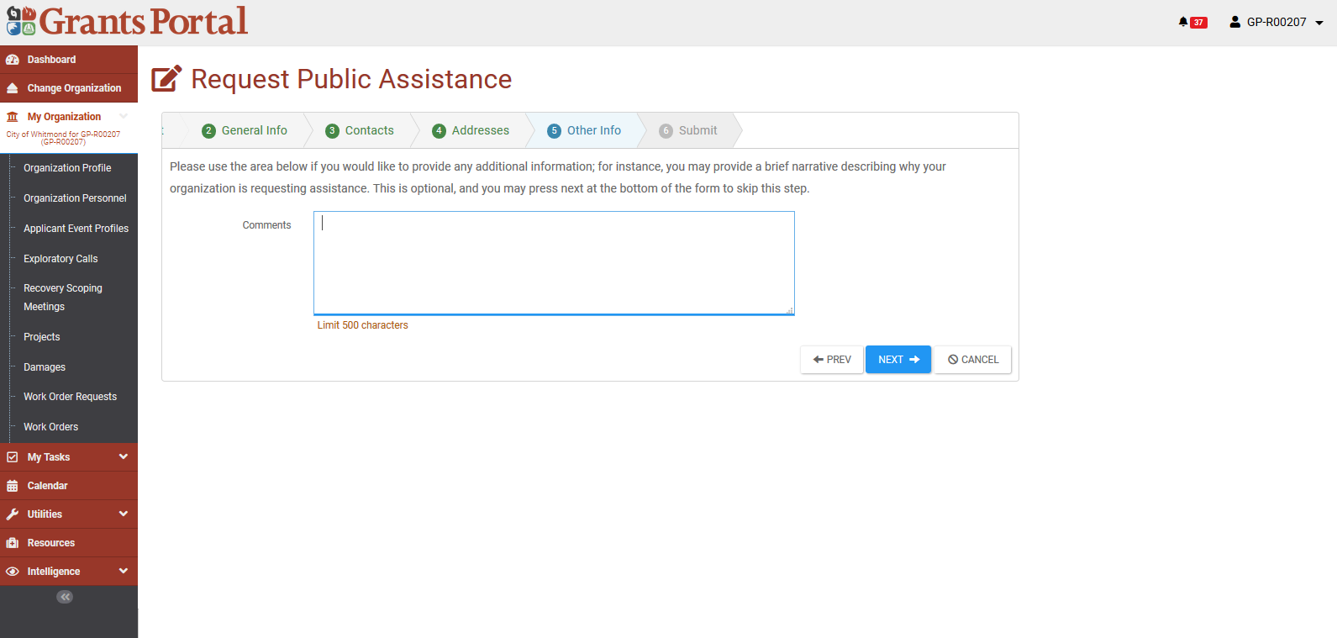
After clicking next, review information on the screen to make sure everything is correct. Click Submit once complete.

Slide 64
Submitting your RPA in the FEMA Grants Portal:
Actions for an Applicant without existing Grants Portal Accounts

Slide 65
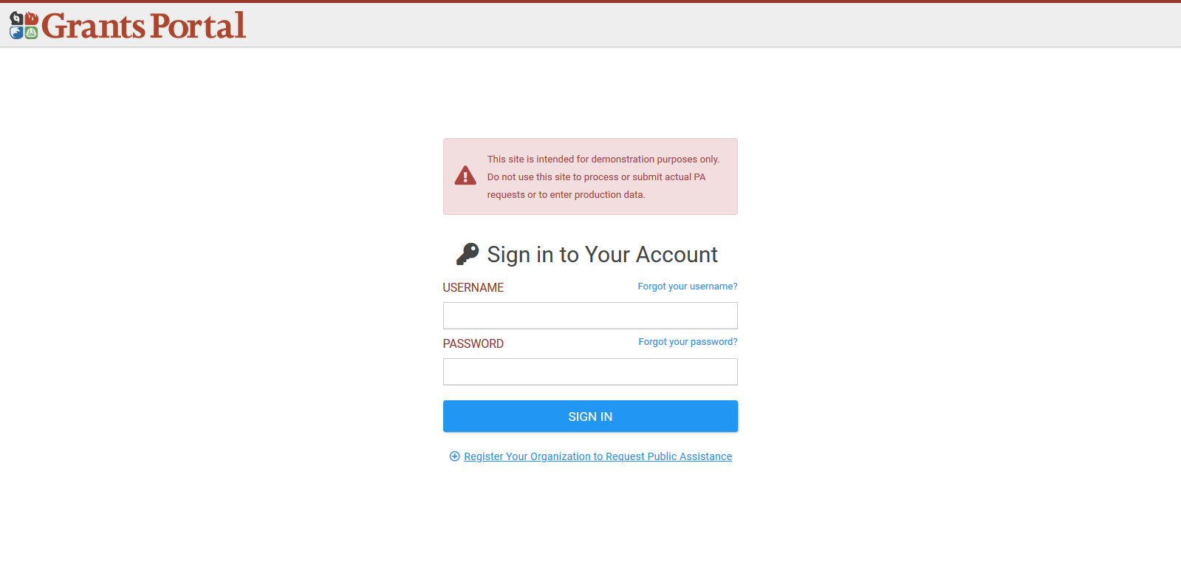
The Applicant goes to the Grants Portal home page at https://grantee.fema.gov/ where they can click “Register your Organization and Request Public Assistance”

Slide 66
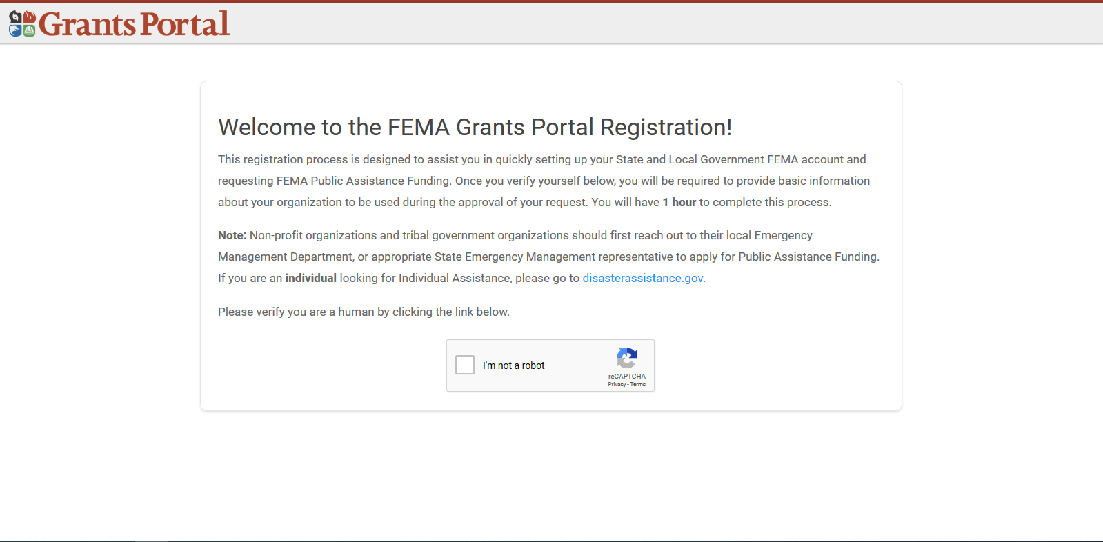

Slide 67
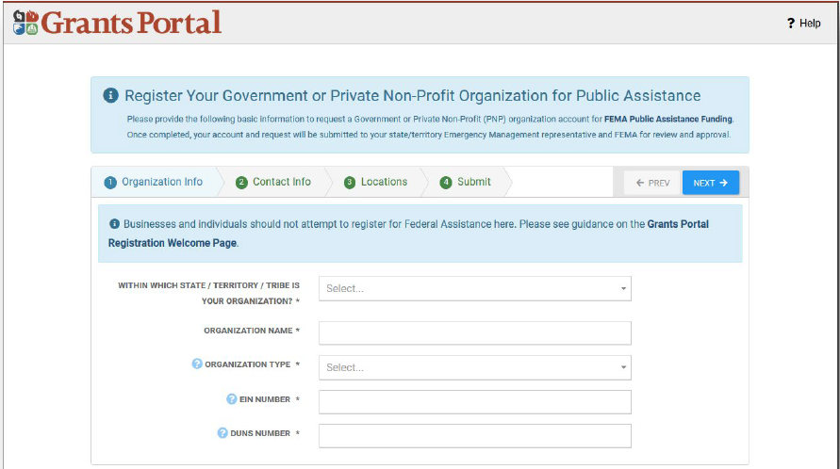

Slide 68
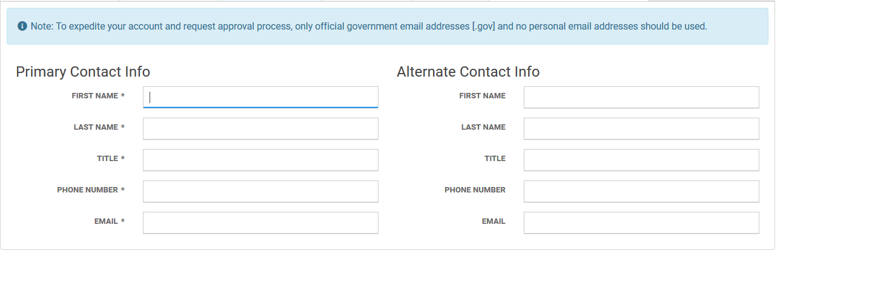
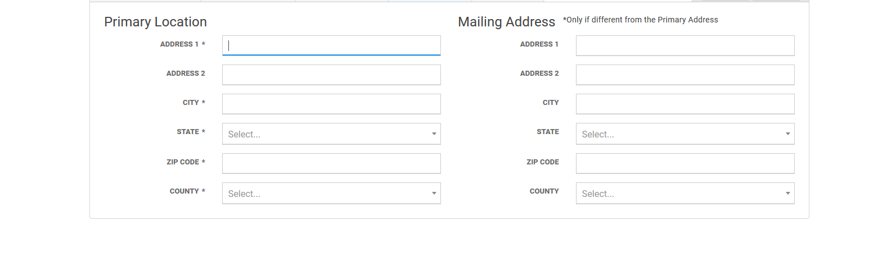

Slide 69
For government entities, if there are events with an open RPA enrollment period in the State/Territory, the Applicant may continue to submit an RPA with this account creation request. If the Applicant chooses to not submit an RPA at account creation, the Recipient will review only the account creation request and the Applicant may submit its RPA later.

Slide 70
Public non-profit entities, such as those that are agencies or instrumentalities of SLTT governments, are generally considered SLTT government entities and do not need to submit additional documentation required by PNP Applicants. These entities should select the government organization type that best describes them. If an Applicant is unsure of its type, it should consult the Recipient.
PNP Applicants must wait for account creation approval from the Recipient before submitting an RPA.
After the Applicant completes the account request and the Recipient and FEMA have approved the RPA request, the Applicant receives a system-generated email with a username and temporary password to gain access to Grants Portal.
The system will then prompt the Applicant to create a permanent password.
Once the Applicant has access to Grants Portal, it can choose to follow the instructions above for Applicants with an existing Grants Portal Account to directly submit an RPA in the system.

Slide 71
Completing and Submitting a Project Application

Slide 72
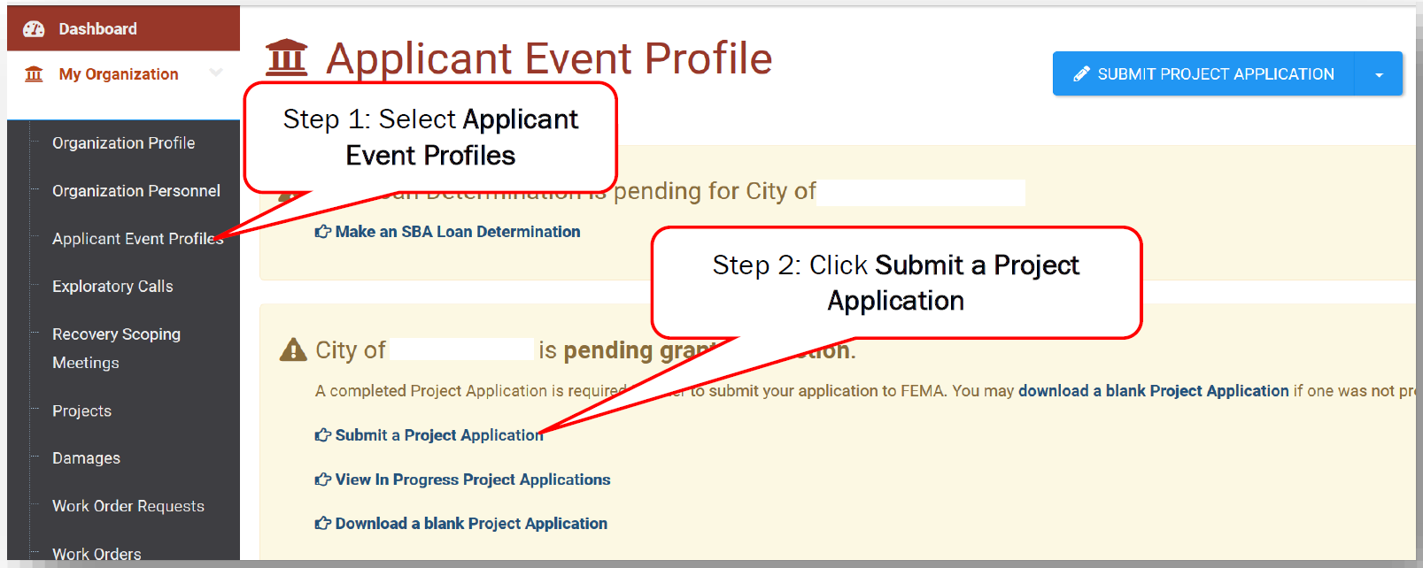
Creating the Project Application

Slide 73
What happens Post Award?
Subrecipient will be required to enter into a grant agreement which contains the federal terms and conditions of awards
Applicants will request reimbursement for your documented costs
You will be required to submit quarterly reports for projects until the project is 100% complete.

Slide 74
VDEM's Priority on Reimbursement Requests
Reduce the risk of federal/state funding de-obligations and return of funds from the sub-recipient in future fiscal years
https://www.fema.gov/assistance/public/appeals

Slide 75
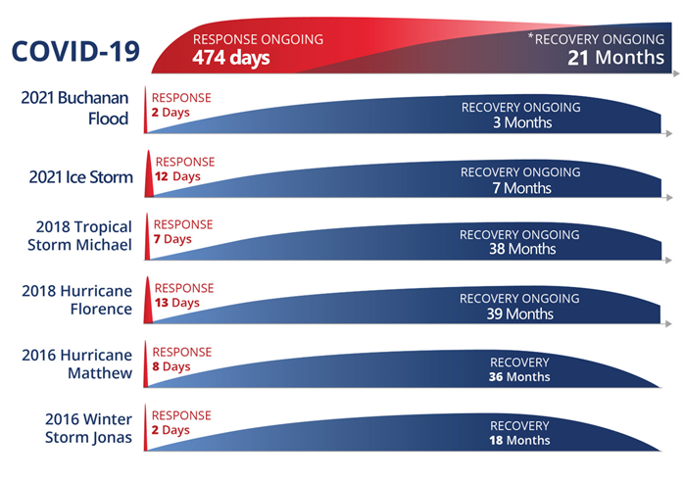
Disaster Timelines

Slide 76
Reimbursement Expectations
Will most likely happen in a future fiscal year
Due to the nature of the program, and post-award requirements on the state, it is difficult to project a reimbursement timeline
  Quality documentation will ensure a shorter timeline for reimbursement

Slide 77
Small Project Reimbursements
For Small Projects (under $139,800)
  Written on Estimates, and Paid on Estimates
  You may request the full federal share (75%) and state share of your total project costs if the work is completed.
  Subrecipients must be compliant with the quarterly reporting requirement

Slide 78
Applicants with Multiple Small Projects
You will need to monitor any potential cost overruns and under-runs across your small projects.
FEMA does not adjust small project amounts unless there is an eligibility concern, or there is a net small project overrun appeal.
See PAPPG page 199 for more details

Slide 79
Large Project Reimbursements
For large projects (above $139,800)
  You must be able to fully document your work completed, costs, and demonstrate proof of payment
  VDEM will hold 10% of the federal share of eligible costs until closeout as a retainer in case of a closeout de-obligation.
  VDEM will hold any applicable state share of eligible costs until closeout.

Slide 80
New Reimbursement Feature
VDEM is beginning to import cost line items from the FEMA PA Data Warehouse so that reimbursement requests can be linked to those line items to easily detect cost overruns, which would require a scope of work change.
Linking the cost line items will also make the final closeout review more efficient.

Slide 81
Closeout (End of the Road)
Once the work is completed and allowable reimbursement requests have been processed and paid, the sub-recipient will need to request that their project be closed in EM Grants.
Will need to do a final summary of expenditures
VDEM and FEMA must do a final review
If all work is completed, lines up with the approved scope of work, and costs are eligible then the project can be closed

Slide 82
State Agencies
For State Agency Transfers, agencies will be required to use the following fund codes:
Federal Trust Fund: 10000
State Sum Sufficient: 02460

Slide 83
Common Terms
Applicants: Entities submitting a request for assistance under the recipient's federal award.
Subrecipients: Applicants who have received a subaward from the Recipient and is then bound by the conditions of the award and subaward.
Recipients: The State or Tribal government that receives funding under the disaster declaration and disburses funding to approved subrecipients.
FEMA: The federal awarding agency authorized to manage the program.

Slide 84
Resources
Public Assistance
VDEM Website: https://www.vaemergency.gov/disasters/2022-01-04-severe-winter-storms/
FEMA PAPPG V.4: https://www.fema.gov/sites/default/files/documents/fema_pappg-v4-updated-links_policy_6-1-2020.pdf
DRRA
Disaster Recovery Reform Act: https://www.fema.gov/disasters/disaster-recovery-reform-act-2018
Section 1206 Code Compliance: https://www.fema.gov/sites/default/files/2020-10/fema_building-dode-floodplain-management-ddministration-enforcement-policy_drra-1206_signed_10-15-2020.pdf
Consensus Based Codes and Standards: https://www.fema.gov/assistance/public/policy-guidance-fact-sheets/section-1235b-consensus-based-codes-and-standards

Slide 85
VDEM Technical Support
For Technical Assistance please note the following contacts:
Geographic Area | PA/Recovery Coordinator | Contact
ALL | Recovery | Recovery@vdem.virginia.gov
ALL | Innovative Emergency Management, Inc. | Vdemcommunications@iem.com

Slide 86
Stay Updated
Register for Grant Updates

Slide 87
Questions

